Slide 1
Replicating and Learning:
Machine Learning-Based Occupancy Estimation Using Multivariate Sensor Nodes[1]
Maryam Chahkandi , <mchahkandi@torontomu.ca> Student Number: 501276281
Supervisor: Dr Tamer Abdou
https://github.com/masram-ml/rpstry-bdap-occup-estmt-

Slide 2
Contents:
Introduction
Methodology
Exploratory Data Analysis
➢ Univariate Statistics
⁃ Outliers
➢ Variables Correlation And Feature Selection
⁃ Best Numerical Features
⁃ Best Categorical Features
➢ Bivariate Statistics
Notes:
Title slide

Slide 3
Modeling And Evaluation
➢ Metrics
➢ Cross-Validation Evaluation
➢ Data Normalization
Result
➢ Baseline Models
⁃ Homogenous
⁃ Heterogenous
➢ Dimensionality Reduction-PCA
➢ Tuning Hyperparameter
Conclusion And Future Work
Notes:
Title slide

Slide 4

Introduction
The objective is accurate estimating of the number of occupants in a room using Machine Learning models, aiming a demand driven approach for energy efficiency
Using the "Room Occupancy Estimation" dataset from UCI Repository[2], the model should aim to provide insights into feature importance

Slide 5
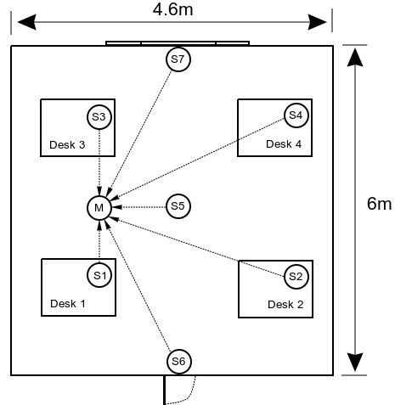
Introduction-Feature Engineering
Multiple sensor nodes in a (6 m x 4.6 m) room transmitting data to the sink periodically(Temp, Light, Sound, PIR(Passive Infrared), CO2)
Data recording for a period of Seven days, creating a final dataset with over 10,000 points and 16 features. Some “Feature Engineering” were done:
Merging timestamps for uniformity due to variations in data arrival times.
Deleting feature vectors with missing PIR and Sound data, for data credibility
A regression based method for calculating a new CO2 slope, from CO2 values, for improved correlation with room occupancy.
Manual building of ground truth: registering the exact time and desk number for individuals entering or leaving the room.

Slide 6
Methodology
Machine Learning Classification Models[10]: SVM(Linear, RBF), Random Forest
(SVC imported from sklearn.svm[11] and RandomForest imported from sklearn.ensemble[12])
Data Manipulation
(pandas, StandardScaler[13] imported from sklearn.preprocessing)
Visualization
(seaborn[7], matplotlib[8].pyplot)
Cross Validation Evaluation[6]
(train_test_split, TimeSeriesSplit, StratifiedKFold, cross_val_score[17], GridSearchCV[20] are imported from sklearn.model_selection)
Statistical Analysis
(skew, chi2_contingency, f_oneway imported from scipy.stats[9])
Feature importance
(mutual_info_classif[21], SelectKBest[15], chi2[16], f_classif[14] imported from sklearn.feature_selection)
Principal Component Analysis[22] (PCA imported from sklearn.decomposition)
Hyperparameter Tuning: (GridSearchCV imported from sklearn.model_selection)

Slide 7
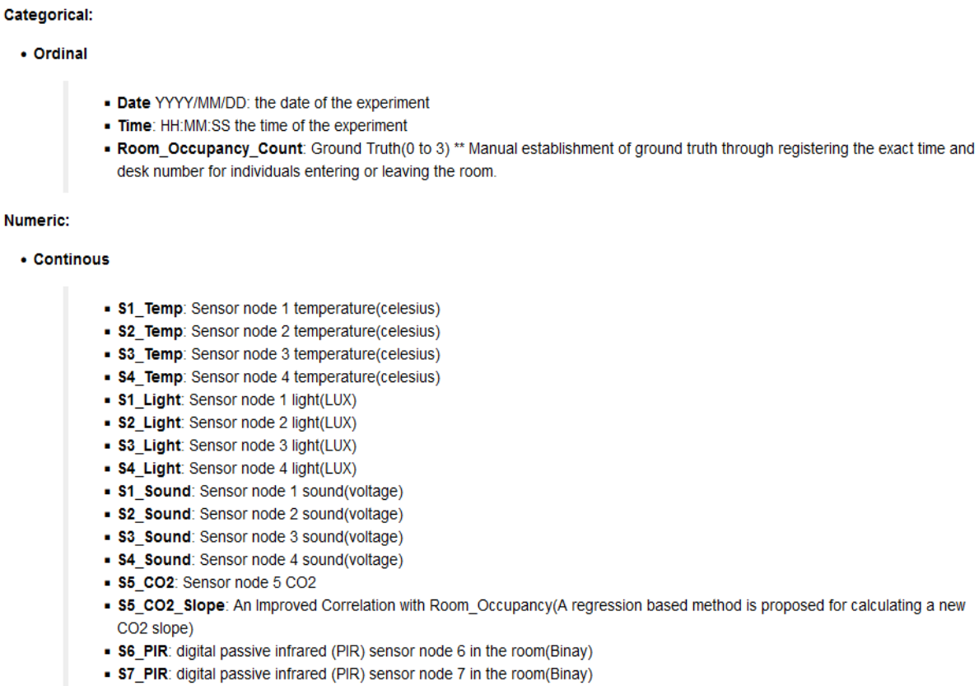
Exploratory Data Analysis
Notes:
Ordinal (just like nominal data type but can be ordered or ranked)
Unit of Measurement

Slide 8
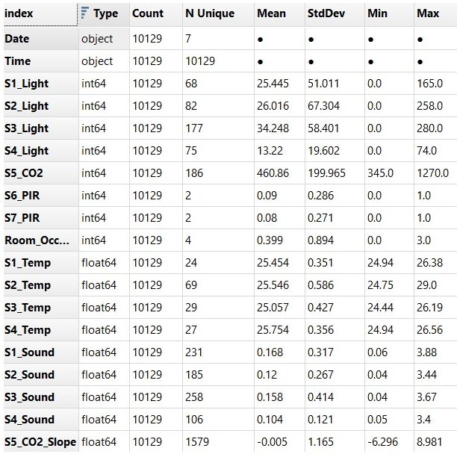
EDA-Univariate Statistics
There are three types of univariate statistics:
General information: (data type, count of total values, number of unique values)
Range and middle:(min, max, mean, median, mode, quartiles)
Normality and spread:(standard deviation, skewness)

Slide 9
EDA-Feature Encoding
Time feature Encoding: It is necessary to transform the “Time” ordinal values into the relevant interval ones.
a new feature created and called “Time_Of_Day”.
Midnight: 00:00:01 to 07:00:00
Morning: 07:00:01 to 12:00:00
Afternoon: 12:00:01 to 17:00:00
Evening: 17:00:01 to 21:00:00
Night: 21:00:01 to 23:59:59

Slide 10
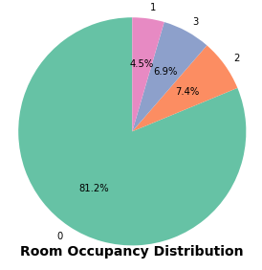
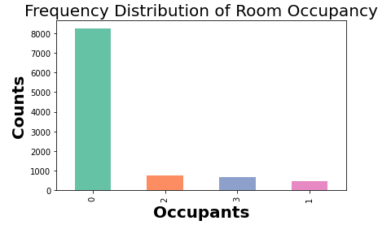
EDA-Ground Truth
Imbalance Dataset: significant portion of instances having no occupants in the room
It's important to be cautious when working with imbalanced datasets, as models may become biased towards the majority class.

Slide 11
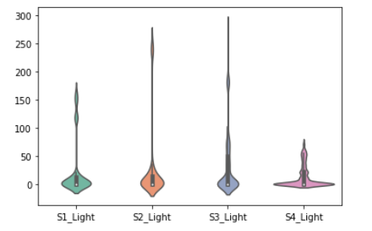
EDA-Outliers
Light Outliers
for all light sensors, there is more density around (0 or no light).
Indoor light: levels range between 100 and 300(LUX),
Outliers: are in range of indoor light level and above the 75th percentile, those are important. Excluding them will lead to the loss of valuable information.
Notes:
LUX: Light Unit of Measurement

Slide 12
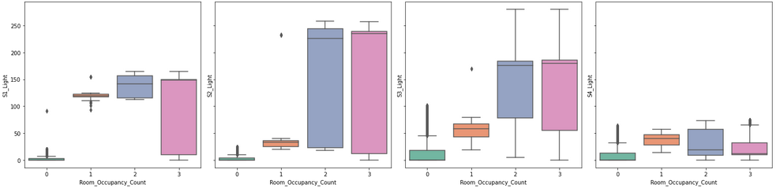
EDA-Outliers
Light Outliers
Unoccupied Rooms: light levels are consistently below 100(LUX), indicating lower variability, with noticeable outlier points.
Occupied Rooms: exhibit a wider and more varied range of light levels with no significant outliers.
Notes:
LUX: Light Unit of Measurement

Slide 13
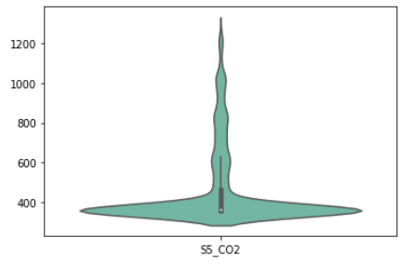
EDA-Outliers
CO2 Outliers
There are many outliers for CO2 sensor, it can be seen that the density is around (400ppm)
Typical Indoor CO2 Level: range between 400 and 1100(ppm), value level greater than 1200(ppm) shows a poor air quality, require ventilation.
Outliers: are in range of indoor CO2 level, those are important. Excluding them will lead to the loss of valuable information.
Notes:
Carbon Dioxide (CO₂) is measured in parts-per-million (ppm)

Slide 14
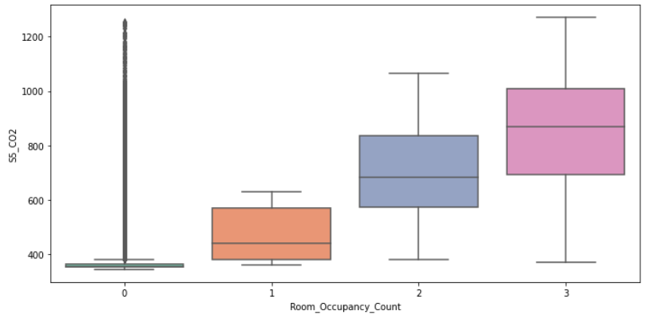
EDA-Outliers
CO2 Outliers
Unoccupied Rooms: CO2 levels are consistently below 400(ppm), indicating lower variability, with noticeable outlier points.
Occupied Rooms: exhibit a wider and more varied range of CO2 levels with no significant outliers.

Slide 15
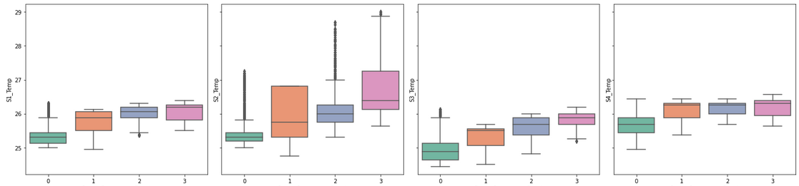
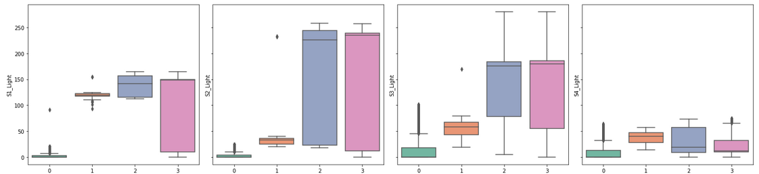
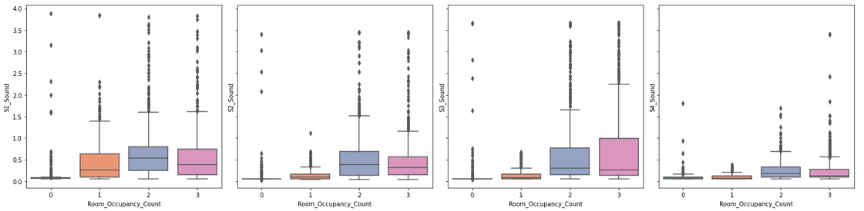
EDA
Light, Sound sensors along with Room_Occupancy exhibit temporal patterns throughout the day, have zero values during the night time and higher values when the room is occupied.
The S2_Temp has recorded higher values.
The sound sensors variable show higher when the room has more than one occupant.

Slide 16
EDA-Bivariate Statistics
Bivariate Statistics: It deals with relationships between two variables, and how the features affect some labels
There are three types of Bivariate statistics:
(NUM/NUM): Numeric to Numeric relationship
(CAT/NUM): Categorical to Numeric relationship
(CAT/CAT): Categorical to Categorical relationship

Slide 17
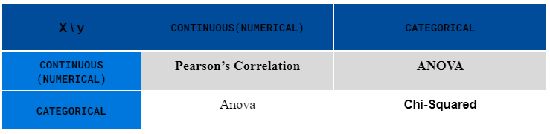
EDA-Feature Selection[4]
This process removes irrelevant and redundant features from the data set
Filter / Wrapper / Embedded methods
The nature of relationship between predictors and target class:
Linear: assuming a linear relationship between X, y
Non-linear: assuming a non-linear relationship between X, y
Linear Assumption: there are 4 Filter Methods to choose from
Notes:
They measure the relevance of the features with the target via statistical tests. In the context of Room Occupancy estimation, X is a set of Numerical/Categorical features and y; Room_Occupancy_Count is Categorical. Therefore, ANOVA for NUM/CAT and Chi_squared for CAT/CAT have been examined.

Slide 18
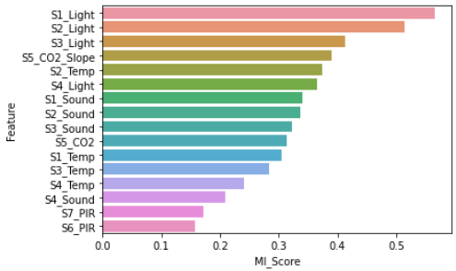
EDA-Variables Correlation And Feature Selection
Non-Linear Assumption
Mutual Information(MI)[5]: the Mutual Information between the features and the target variable has been considered. MI ranges from 0 (no mutual information) and 1 (perfect correlation).
MI_Score: The higher score means more dependent variables, to Room_Occupancy_Count.
Notes:
Sklearn offers implementation for classification tasks. MI measures the amount of information one variable provides about another and is not limited to linear relationships. I have used the Mutual_info_classif method that utilizes the mutual information. It calculates mutual information value(the dependency) for each of independent variables with respect to dependent variable.

Slide 19
EDA-ANOVA
ANOVA Test:
Null Hypothesis (H0):
The means of Room_Occupancy_Count are equal across different levels of the specified features
Alternative Hypothesis (Ha):
There is a significant difference in means

Slide 20
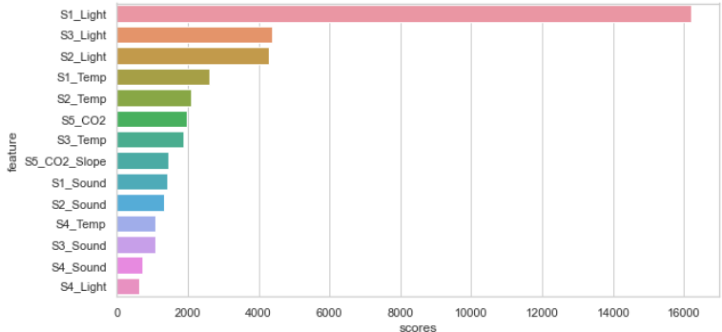
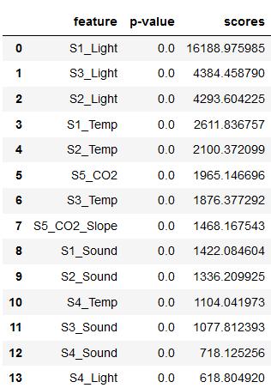
EDA-Best Numeric Features
ANOVA Test: the score function for finding dependency of numeric features, for classification of Room_Occupancy_Count, The more the dependency the more important will be the feature.
Notes:
I have used the F_classif as a score function of SelectKBest, for selecting the best k features based on Anova F-value returns (F-statistic scores, p values). For classification, SelectKBest has chi2, f_classif, mutual_info_classif methods, which based on F-test, estimate the degree of linear dependency between two random variables.

Slide 21
EDA-Best Numeric Features
P-value of 0.0: suggesting that there are significant differences in means between groups.
High scores: reflect feature importance in predicting Room_Occupancy_Count.
S1_Light, S3_Light, and S2_Light: exhibit particularly high scores, emphasizing their substantial impact on predicting room occupancy.

Slide 22
EDA-Chi-Squared
Null Hypothesis (H0):
There is no significant association between Room_Occupancy_Count and features, the distribution of target class is independent of them.
Alternative Hypothesis (Ha):
There is a significant association between Room_Occupancy_Count and features, the distribution of target class is dependent on them.

Slide 23
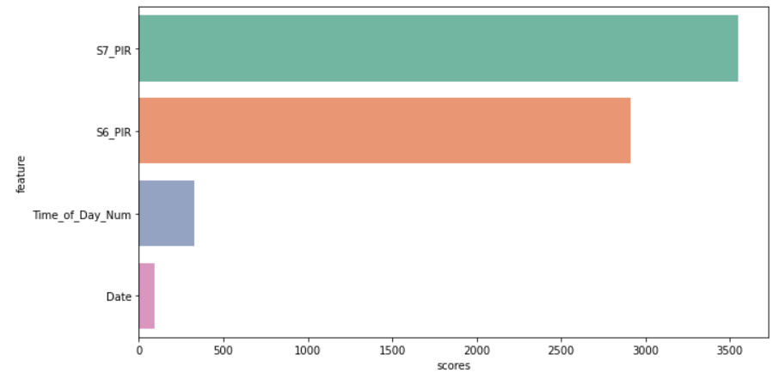
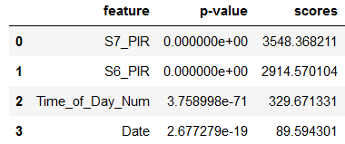
EDA-Best Categorical Features
Chi-Square[3]: statistical test that is used to determine whether there is a significant difference between the observed frequencies of a categorical variable and the expected frequencies.
Notes:
chi2 as a score function of SelectKBest, for selecting the best k features based on chi-squared stats returns (Chi2 statistic scores, p values).
It is necessary to transform the Time categorical values into the relevant interval ones, for further processing. (Feature Time has been encoded into new feature ‘Time_of_Day_Num’)

Slide 24
EDA-Best Categorical Features
S7_PIR, S6_PIR: p-values of 0.0, indicating a highly significant association with Room_Occupancy_Count. The scores are also relatively high, suggesting a strong dependency.
Time_of_Day_Num: p-value of 3.76e-71, indicating an extremely significant association. The high score (329.67) suggests a strong dependency.
Date: p-value of approximately 2.68e-19, indicating a highly significant association with Room_Occupancy_Count. The score (89.59) suggests a dependency.

Slide 25
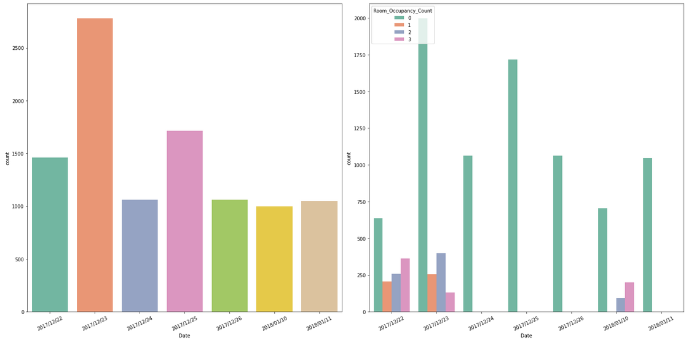
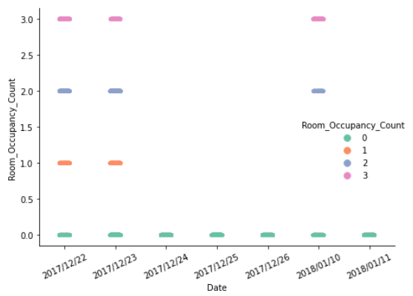
EDA-Bivariate Statistics(CAT/CAT)
The Room_Occupancy_Count on the following three dates —"2017/12/23", "2017/12/22" and "2018/01/10" — indicates an occupancy(Room_Occupany_Count>=1).
On the other days, there are too many instances of No occupancy in the data.

Slide 26
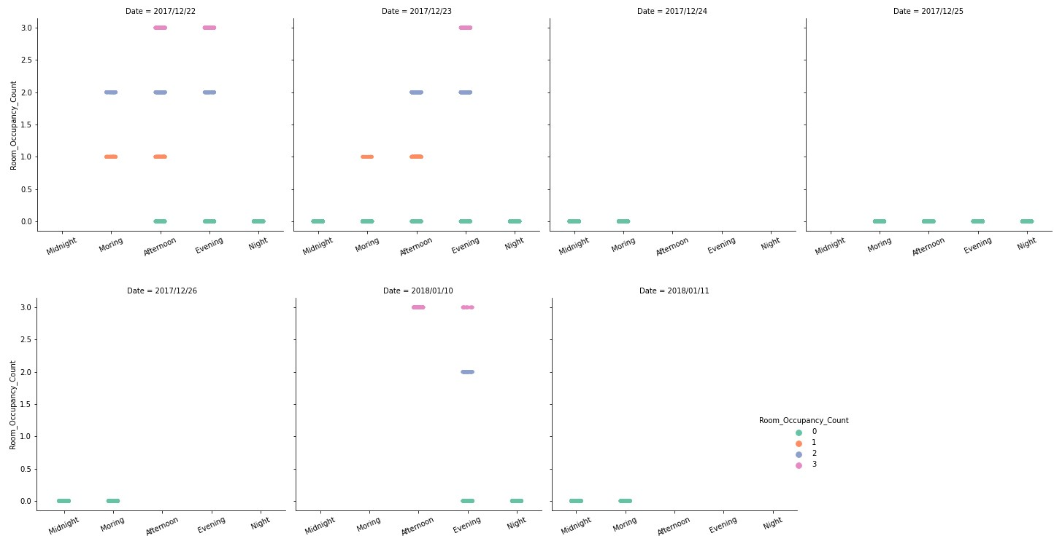
EDA-Bivariate Statistics(CAT/CAT)

Slide 27
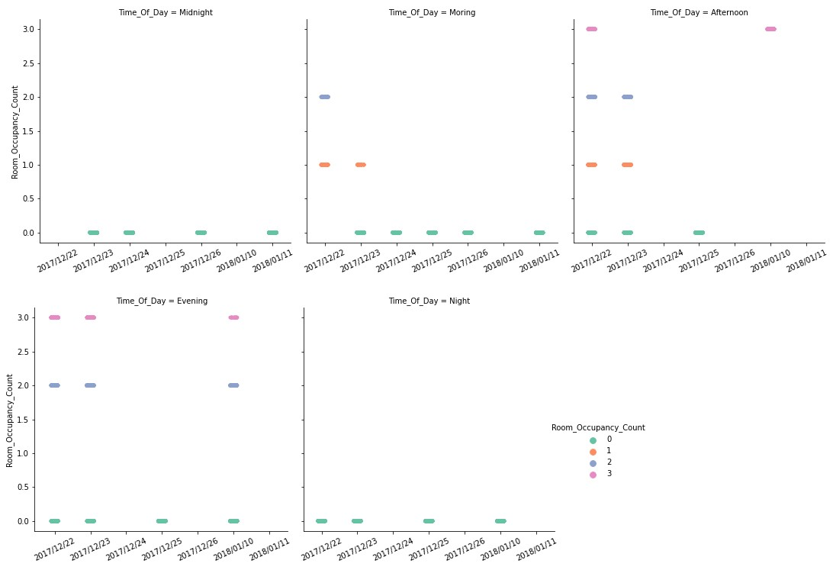
EDA-Bivariate Statistics(CAT/CAT)
The Room_Occupancy_Count on the following three ‘Time_Of_Day’s —"Morning", "Afternoon", and "Evening" — indicates an occupancy of more than 1
On Midnight and Night time, there are instances of zero occupancy

Slide 28
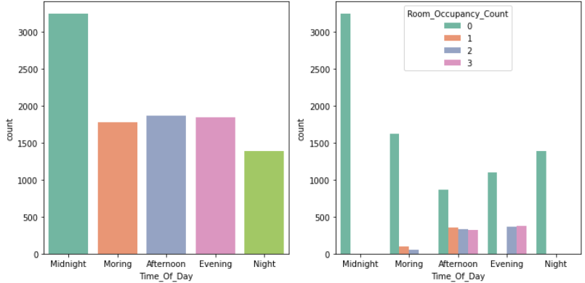
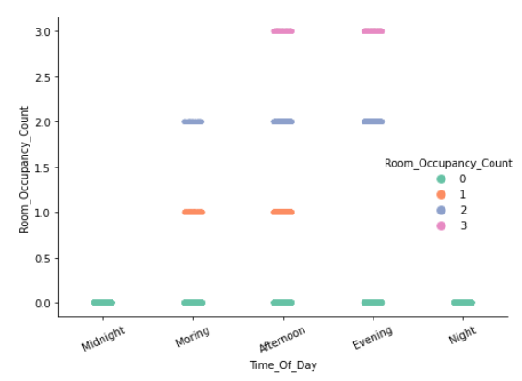
EDA-Bivariate Statistics(CAT/CAT)

Slide 29
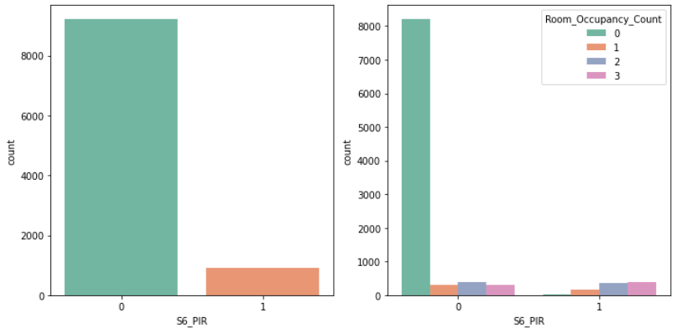
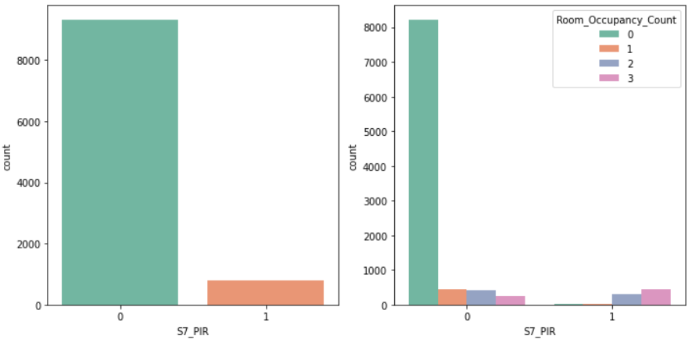
EDA-Bivariate Statistics(CAT/CAT)
The majority of instances are captured with a value of 0(absence of motion), rather than 1(presence of motion).
The instances with zero occupants coincide with the absence of motion
There are a few instances where the sensor detects motion, but there are zero occupants. This could be due to the sensor picking up motion from sources other than human occupants

Slide 30
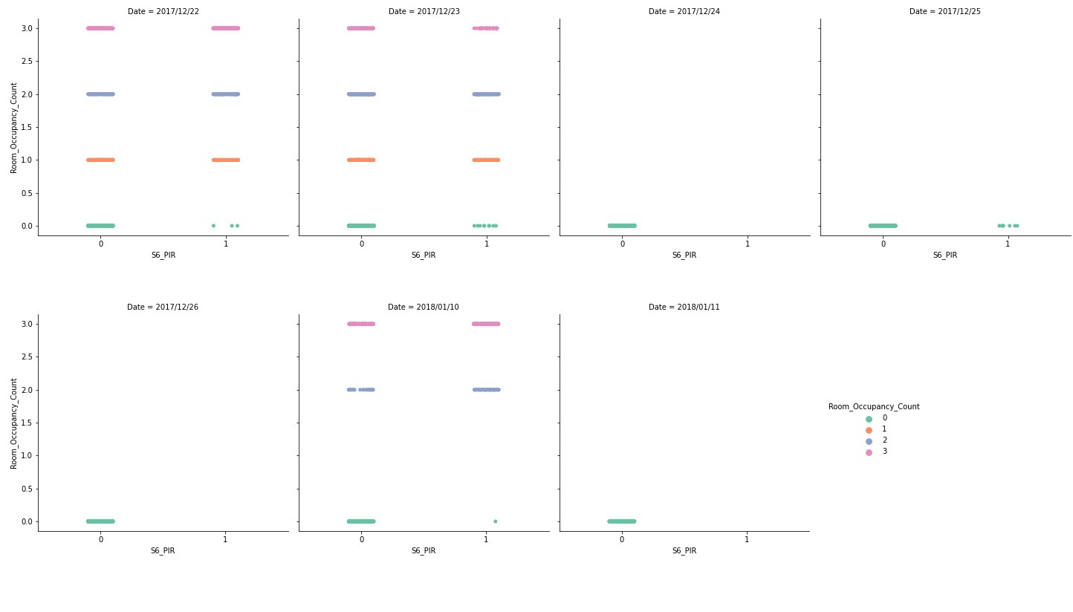
EDA-Bivariate Statistics(CAT/CAT)

Slide 31
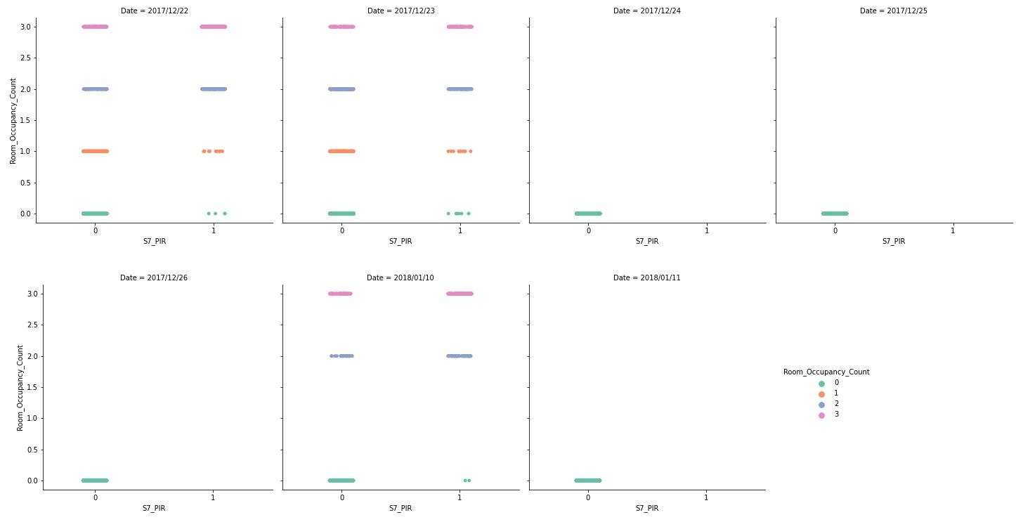
EDA-Bivariate Statistics(CAT/CAT)

Slide 32
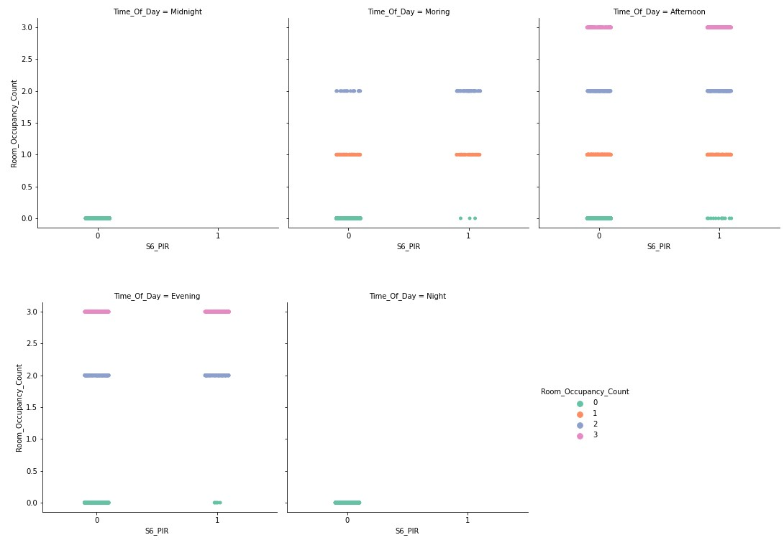
EDA-Bivariate Statistics(CAT/CAT)

Slide 33
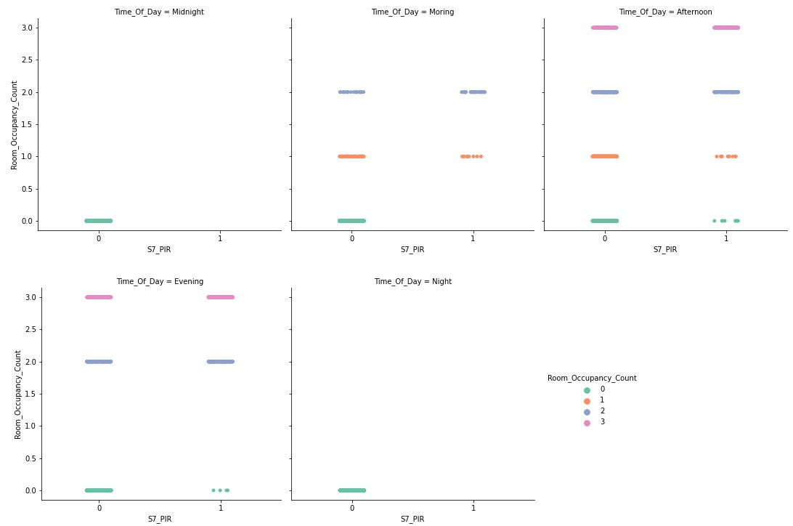
EDA-Bivariate Statistics(CAT/CAT)

Slide 34
EDA-Bivariate Statistics(CAT/CAT)
The values of S6_PIR and S7_PIR implies that:
on the following three dates —"2017/12/23", "2017/12/22" and "2018/01/10" —
on the following three ‘Time_Of_Day’s—"Morning", "Afternoon" and "Evening" —
sensors are capturing instances of motion when there are occupants in the room.

Slide 35
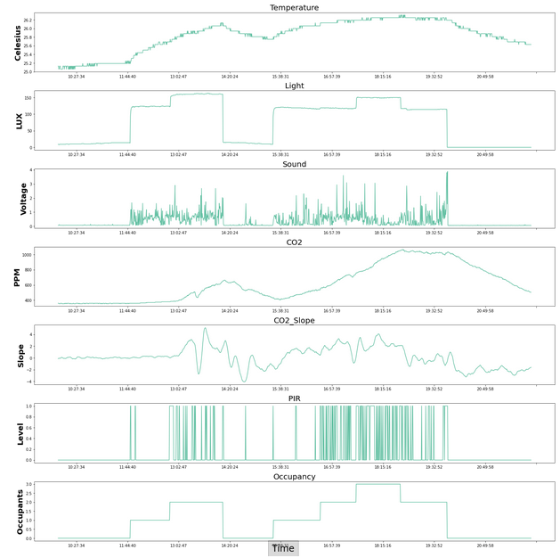
EDA-Sensors vs Time
The time-series plots of the sensors, all data seemed to give an excellent deviation to the number of occupants in the room
Visualizing data from selective sensors and the CO2 slope for a period of 12 hours on 23/12/2017

Slide 36
Modeling And Evaluation
The best performed machine learning models for classification were built:
Linear SVM, RBF kernel SVM
Random Forest (RF)
Model building was done in two phases:
Homogeneous phase: using one homogeneous sensor group, individually to examine the model.
Heterogeneous phase: using combination of homogeneous sensors. The focus is on examining the outperforming of the combined sensors.
Dimensionality Reduction using PCA was conducted

Slide 37
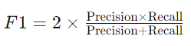
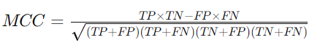
Classification Model Performance-Metrics
Tools: model_selection.cross_val_score and sklearn.metrics
Scorer Parameter[18] to measure classification performance: f1_score, Accuracy, MCC
F1 Score for Multiclass
'Macro' average: (unweighted”)
Harmonic mean of precision and recall
Both FP and FN are considered for each label
Matthews Correlation Coefficient (MCC)[19]
Measures multiclass quality
Ranges: -1(random) to +(perfect) predict
All TP, TN, FN, and FP are considered
In the context of class imbalance, equal importance is assigned to all classes:
MCC and f1 Score with ‘Macro’ average is a good decision: it treats each class with equal significance
Providing balanced measure
Confusion Matrix Function
Evaluates classification metrics

Slide 38
Cross-Validation Evaluation
Time-Series in nature and Class Imbalance:
Combination of TimeSeriesSplit with a nested StratifiedKFold
TimeSeriesSplit:
Temporal order is preserved during cross-validation
Avoiding data points similar to the test data, getting into the training data
StratifiedKFold:
Each fold maintains a balanced distribution of Room_Occupancy_count class
Preventing from being biased toward the majority class

Slide 39
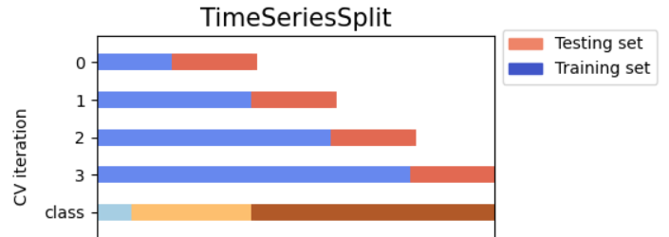
Cross-Validation Evaluation
TimeSeriesSplit
Split the data into k folds, Each fold contains data points that occurred after the ones in the previous fold
In each iteration, the training set includes past data, and the test set includes future data
Each subset has been used as a test set exactly once, ensuring that the model is tested on unseen data

Slide 40
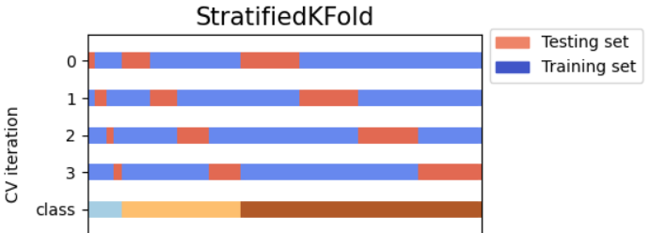
Cross-Validation Evaluation
StratifiedKFold
It only and always shuffles the fold from TimeSeriesSplit, one time before splitting
Split the data into k folds, ensuring that each fold contains a balanced representation of target classes
Iteratively train the model on k-1 fold, validate on ramined fold, save validation result, repeat it for k times and finally average the result to obtain the final performance

Slide 41
Data Normalization
Normalization: transformation to ensure that features are on a similar scale.
This is crucial for the models that are sensitive to features with large/small scales.
Features with large/small scales can lead to less model performance.
StandardScaler: transforming the features to have zero mean and a standard deviation of 1.
Only the training set features have been used to calculate normalization.
The normalization obtained from the training set then has been applied to both the training and testing sets consistently.

Slide 42
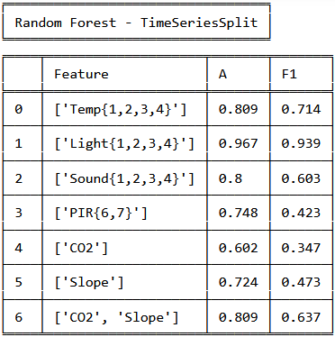
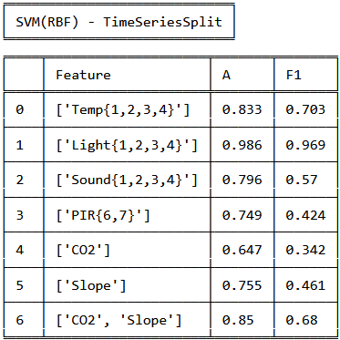
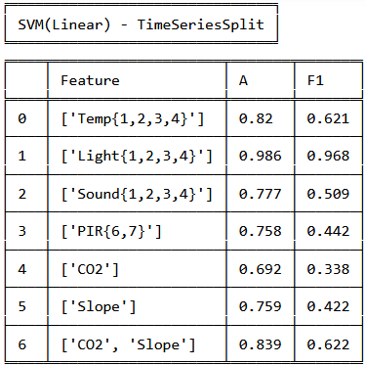
Baseline Models-Homogeneous Phase
The Light is the best-performing feature set across all three models.
SVM(with RBF kernel) performs slightly better among the other models.
The bias towards Light can be explained as people switch on lights when arrival and turn them off on leaving. Relying only on Light leads to false positive, when a person may leave with lights on.
Even with as low as 4 Temp features, SVM with RBF kernel gives an accuracy of around 83% and a moderate F1 score of 0.703.

Slide 43
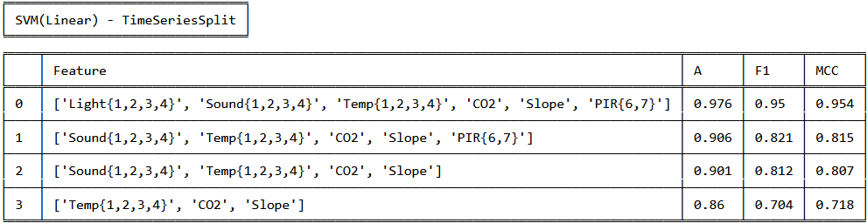
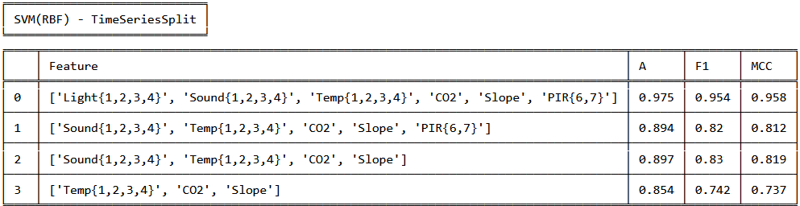
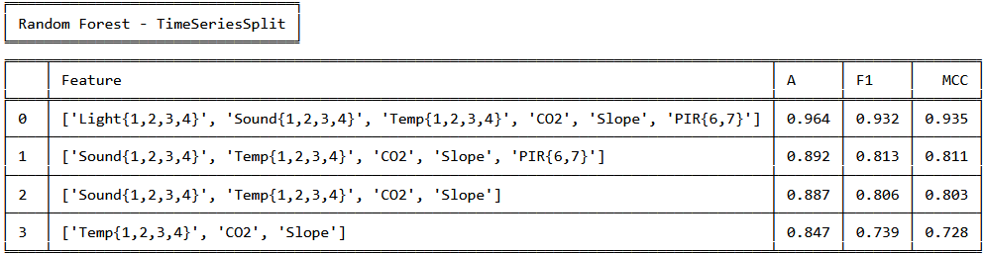
Baseline Models-Heterogeneous Phase
SVM with RBF kernel performed better than linear SVM for most cases.
When complete dataset is considered, SVM(RBF) performs slightly better among the other three models.
When light features are not considered, SVM(Linear) performs slightly better among the other three models.
F1 Score and MCC are, the metrics that consider both false positives and false negatives. However, MCC is considered more robust for imbalanced datasets.

Slide 44
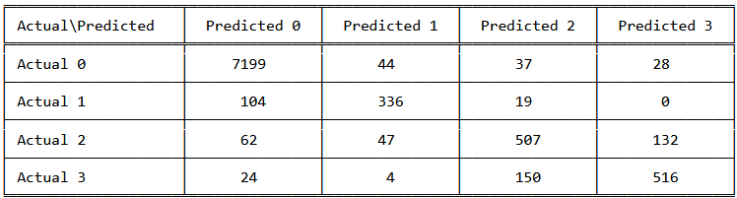
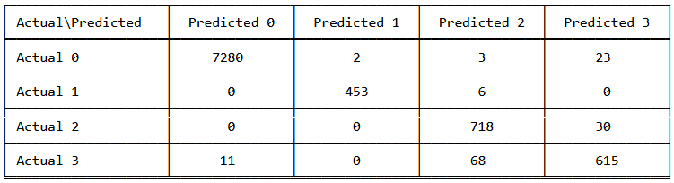
Baseline Models-Heterogeneous Phase
Precision
Focuses on accuracy in identifying occupied rooms, reducing unnecessary energy consumption.
Recall (Sensitivity)
Focuses on capturing actual occupied instances, minimizing discomfort for occupants.
Precision-recall Balancing
Accuracy in identifying most occupied instances, minimizing energy inefficiency and discomfort.
F1 Score and MCC metrics, considering both false positives and false negatives,
best performance:
Dataset with no light features: SVM (Linear) model.
Complete dataset: SVM (RBF) model.
CONFUSION MATRIX FOR LINEAR SVM CASE FOR THE COMPLETE
DATASET DEVOID OF LIGHT FEATURES
CONFUSION MATRIX FOR SVM WITH RBF KERNEL CASE FOR THE
COMPLETE DATASET
The confusion matrices for the best case in both the feature sets

Slide 45
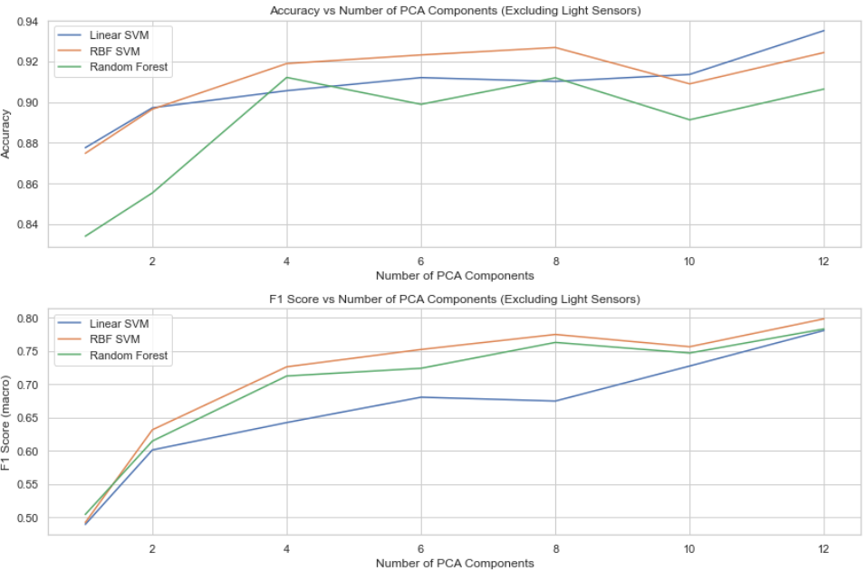
Dimensionality Reduction-PCA
Performance of light sensors
bias towards light
false positives when individuals leave the room with lights still on
Principal Component Analysis (PCA)
Feature set without light
Number of PCA: (2, 4, 6, 8, 10, 12)
Even with as low as four components, SVM with RBF kernel gives an accuracy of 92% and a moderate F1 score of 0.72
Random Forest also shows a similar performance.

Slide 46
Tuning Hyperparameter
Hyperparameter tuning using GridSearchCV was performed
Random Forest model Common hyperparameters:
'n_estimators': the number of trees, [50, 100, 200]
'max_depth': the maximum depth of the trees, [None, 10, 20]
'min_samples_split': the minimum samples required to split an internal node, [2, 5, 10]
Best hyperparameters: Extracted using grid_search.best_params_, on the train_set.
Model has used Best Parameters to process on the validation_set
Model evaluation has been predicted on the test_set

Slide 47
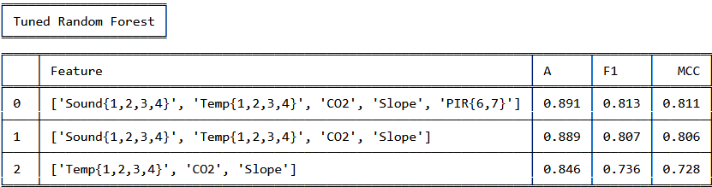
Tuning Random Forest Model
Tuned Random Forest model vs baseline RF model: comparable results
Suggestion: The baseline model, without extensive tuning, is proving to be both reliable and robust in its ability to estimate occupancy accurately.
This finding proves confidence in the effectiveness of the baseline models.

Slide 48
Conclusion and Future work
A Pipeline:
Feature Combination
Custom Cross-Validation: (TimeSeriesSplit with nested StratifiedKFold)
Evaluations of best Performed Models: SVM(Linear, RBF), Random Forest
Metrics: Accuracy, F1 score, and Matthews Correlation Coefficient(MCC)
Dimensional Reduction: Principal Component Analysis(PCA) no lights
Tuning Models: Best Hyperparameter for a tuned Random Forest

Slide 49
Conclusion and Future work
Feature Importance:
Temperature and CO2, played a significant role in predicting room occupancy
The Light is the best-performing feature
Excluded Light because relying on light can lead to false positives when individuals leave the room with lights still on.
Cross-Validation Strategy:
TimeSeriesSplit combined with nested StratifiedKFold addressed time-series nature and class imbalance.
Model Performance:
SVM (Linear) and SVM (RBF) exhibited competitive performance
Random Forest also provided reliable results
Using SVM with RBF kernel for a complete feature set show a promising 97.5% accuracy of occupancy with a high F1 score of 0.954.

Slide 50
Conclusion and Future work
Dimensionality Reduction:
Even with as low as four components, SVM with RBF kernel gives an accuracy of 92% and a moderate F1 score of 0.72
Hyperparameter Tuning:
GridSearchCV utilized for hyperparameter tuning
Hyperparameters tuned for Random Forest model
comparing the performance metrics of the tuned Random Forest model and the baseline RF model, reveals comparable results
It proved confidence in the effectiveness of the baseline model

Slide 51
Conclusion and Future work
The findings of the pipeline that is approached, suggested:
competitive performance for all SVM (Linear) and SVM (RBF), and Random Forest ML models.
Reliable results for developing accurate and reliable room occupancy estimation.
Moving forward, consideration of other algorithms and ensemble methods could be explored for further improvement

Slide 52
References:
[1] Adarsh Pal Singh, Vivek Jain, Sachin Chaudhari, Frank Alexander Kraemer, Stefan Werner and Vishal Garg, "Machine Learning-Based Occupancy Estimation Using Multivariate Sensor Nodes," in 2018 IEEE Globecom Workshops (GC Wkshps), 2018.
[2] https://archive.ics.uci.edu/dataset/864/room+occupancy+estimation
[3]Whatley, M. (2022). One-Way ANOVA and the Chi-Square Test of Independence. In: Introduction to Quantitative Analysis for International Educators. Springer Texts in Education. Springer, Cham. https://doi.org/10.1007/978-3-030-93831-4_5
[4]https://scikit-learn.org/stable/modules/feature_selection.html#univariate-feature-selection, https://medium.com/analytics-vidhya/feature-selection-73bc12a9b39e , https://medium.com/analytics-vidhya/feature-selection-85539d6a2a88 , https://medium.com/analytics-vidhya/feature-selection-embedded-methods-a7940036973f
[5]https://www.freecodecamp.org/news/how-machines-make-predictions-finding-correlations-in-complex-data-dfd9f0d87889/
[6] https://neptune.ai/blog/cross-validation-in-machine-learning-how-to-do-it-right , https://scikit-learn.org/stable/modules/cross_validation.html#cross-validation , https://scikit-learn.org/stable/auto_examples/model_selection/plot_cv_indices.html

Slide 53
References:
[7] https://seaborn.pydata.org/
[8] https://matplotlib.org/
[9] https://scipy.org/
[10]https://medium.com/@dannymvarghese/comparative-study-on-classic-machine-learning-algorithms-part-2-5ab58b683ec0
[11]https://scikit-learn.org/stable/modules/svm.html
[12]https://scikit-learn.org/stable/modules/ensemble.html
[13]https://scikit-learn.org/stable/modules/generated/sklearn.preprocessing.StandardScaler.html
[14]https://scikit-learn.org/stable/modules/generated/sklearn.feature_selection.f_classif.html#sklearn.feature_selection.f_classif
[15]https://scikit-learn.org/stable/modules/generated/sklearn.feature_selection.SelectKBest.html#sklearn.feature_selection.SelectKBest

Slide 54
References:
[16]https://scikit-learn.org/stable/modules/generated/sklearn.feature_selection.chi2.html#sklearn.feature_selection.chi2
[17]https://scikit-learn.org/stable/modules/generated/sklearn.model_selection.cross_val_score.html
[18]https://scikit-learn.org/stable/modules/model_evaluation.html#scoring-parameter
[19]https://scikit-learn.org/stable/modules/generated/sklearn.metrics.matthews_corrcoef.html#sklearn.metrics.matthews_corrcoef
[20]https://scikit-learn.org/stable/modules/generated/sklearn.model_selection.GridSearchCV.html
[21]https://scikit-learn.org/stable/modules/generated/sklearn.feature_selection.mutual_info_classif.html
[22]https://scikit-learn.org/stable/modules/generated/sklearn.decomposition.PCA.html

